Slide 1
BUS 243 – Database Management
Database Design for Cryptocurrencies
By Qianhui Lu, Shenquan Wang, Yihui Zhou

Slide 2

Agenda
01
Introduction to Cryptocurrencies
02
Database Design & Launch
03
Database Demonstration
04
Results & Visualization

Slide 3
Introduction to Cryptocurrencies

Slide 4
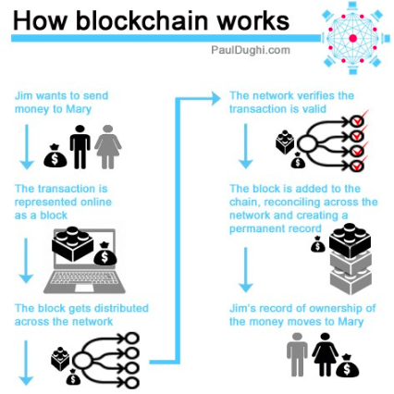
Blockchain
Blockchains:
a growing list of records, called blocks, which are linked using cryptography
Information not just decentralized but distributed.
No central company or person owns the system.
Extremely difficult for anyone to take down the network or corrupt it.

Slide 5
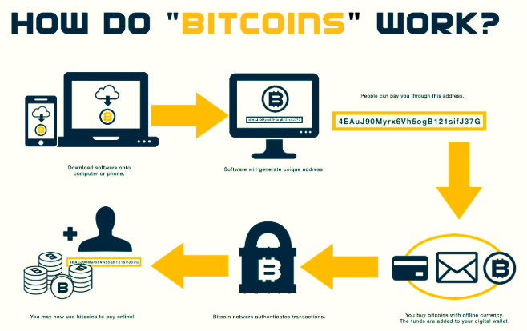
Bitcoin
Bitcoins:
It is different from credit cards, PayPal or other ways to send money.
People from all over the world are validating others’ Bitcoin transactions.
Bitcoin using blockchains by tracking records of ownership.

Slide 6
Database Design & Launch

Slide 7

Our customer: Star Investment Fund
Our customer mission:
looking to generate superior risk-adjusted return for ultra high net worth investors and families
Our study:
Provide advice from research and tools (database) on whether to enter the cryptocurrencies market

Slide 8
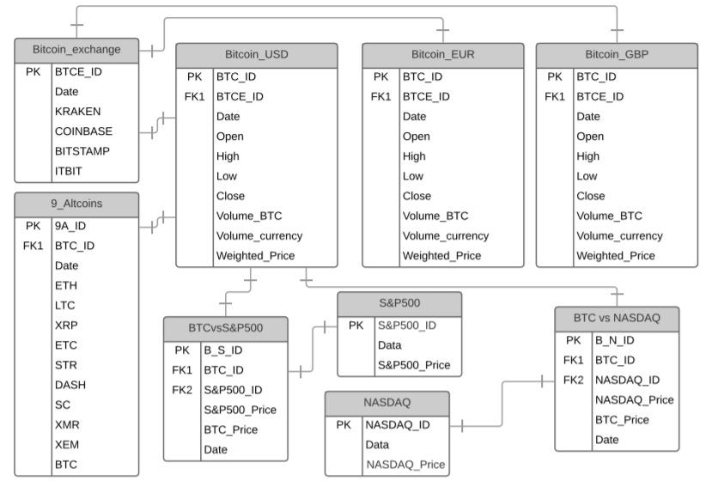
Entity Relationship Diagram

Slide 9
Data Source
Quandl’s Bitcoin API
01
Quandl offers free Bitcoin exchange rates for 30+ currencies from a variety of exchanges.
Poloniex API
02
Poloniex is a pure crypto to crypto exchange based in the United States. With a grand redesign in early 2015 the site has added a wealth of features to provide a fully immersive trading experience.
Yahoo! Finance
03
Yahoo! Finance provides financial news, data and commentary including stock quotes, press releases, financial reports, and original content.
Online Blogs and Resources
04
Thank you, open source!

Slide 10
Building Database
Jupyter Notebook
open-source web application that allows you to create and share documents that contain live code, equations, visualizations and narrative text.
Online Resources
Data Cleaning & Coding
Quandl,
Poloniex
Yahoo Finance
Python Packages
Data Cleaning
How to handle zeros in the dataset?
How to convert Altcoins prices to USD?
Coding
API helper function
Cache
Create-engine
Jupyter Notebook
Python Packages
We used below packages:
Numpy,
Pandas,
Pickle,
Quandl
Plotly
Sqlalchemy (create engine)
Pymysql
Online Resources

Slide 11
Database Demonstration

Slide 12
Build Graphical User Interface
Design GUI
Understand what we want/ don’t want to query for
Sketch layout
Candidates:
Data Cleaning & Coding
HTML: MySQL password hashing has been updated
PHP: server-side, not dynamic
MySQL Stored Procedure
Python GUI (winner!)
Python Packages
Data Cleaning
Clean up date format with str_to_date, date_format
MySQL date format: upper vs lower case
Coding Lessons Learned
Writing GUI
Error handling with separate variable
Writing SQL in Python: % and %%
Jupyter Notebook
Python Packages
We used below packages:
Tkinter
Pymysql
Pandas
Time
Messagebox
Datetime
Re
Os
Select Technology
Notes:
SELECT Close FROM nasdaq_price WHERE date_format(STR_TO_DATE(Date, '%%m/%%d/%%Y'), '%%Y-%%m-%%d') = '%s' ;

Slide 13
Build Graphical User Interface
Design GUI
Understand what we want/ don’t want to query for
Sketch layout
Candidates:
Data Cleaning & Coding
HTML: MySQL password hashing has been updated
PHP: server-side, not dynamic
MySQL Stored Procedure
Python GUI (winner!)
Python Packages
Data Cleaning
Clean up date format with str_to_date, date_format
MySQL date format: upper vs lower case
Coding Lessons Learned
Writing GUI
Error handling with separate variable
Writing SQL in Python: % and %%
Jupyter Notebook
Python Packages
We used below packages:
Tkinter
Pymysql
Pandas
Time
Messagebox
Datetime
Re
Os
Select Technology
Notes:
SELECT Close FROM nasdaq_price WHERE date_format(STR_TO_DATE(Date, '%%m/%%d/%%Y'), '%%Y-%%m-%%d') = '%s' ;

Slide 14
Entity Relationship Diagram
Flash back to ERD ➔

Slide 15
Query – what we want/don’t want to know
BTC Price in Different Currencies
BTC Volume in Different Currencies
Bitcoin is the most widely held cryptocurrency. We want to know how BTC price fluctuates at different times in different currencies.
BTC trading volume information can help us understand the liquidity of BTC in different markets and help us shape investment decisions.
Trends
Time Series Data
Alternative Coin Performance in USD
We don’t want to use query to show price trends because trends are hard to visualize from a bunch of data points and can be better studied in charts.
We want to query for alternative coin performance to explore other cryptocurrency investment options and diversify our portfolio.
BTC Price in USD in details
Stock Market Performance in USD
We want to query for BTC high, low, open and close prices to understand and mitigate investment volatility.
We want to query for the stock market performance so that we can use as benchmark to compare with cryptocurrency performance based on the macro economy scale.

Slide 16
Build Graphical User Interface
Design GUI
Understand what we want/ don’t want to query for
Sketch layout
Candidates:
Data Cleaning & Coding
HTML: MySQL password hashing has been updated
PHP: server-side, not dynamic
MySQL Stored Procedure
Python GUI (winner!)
Python Packages
Data Cleaning
Clean up date format with str_to_date, date_format
MySQL date format: upper vs lower case
Coding Lessons Learned
Writing GUI
Error handling with separate variable
Writing SQL in Python: % and %%
Jupyter Notebook
Python Packages
We used below packages:
Tkinter
Pymysql
Pandas
Time
Messagebox
Datetime
Re
Os
Select Technology
Notes:
SELECT Close FROM nasdaq_price WHERE date_format(STR_TO_DATE(Date, '%%m/%%d/%%Y'), '%%Y-%%m-%%d') = '%s' ;

Slide 17
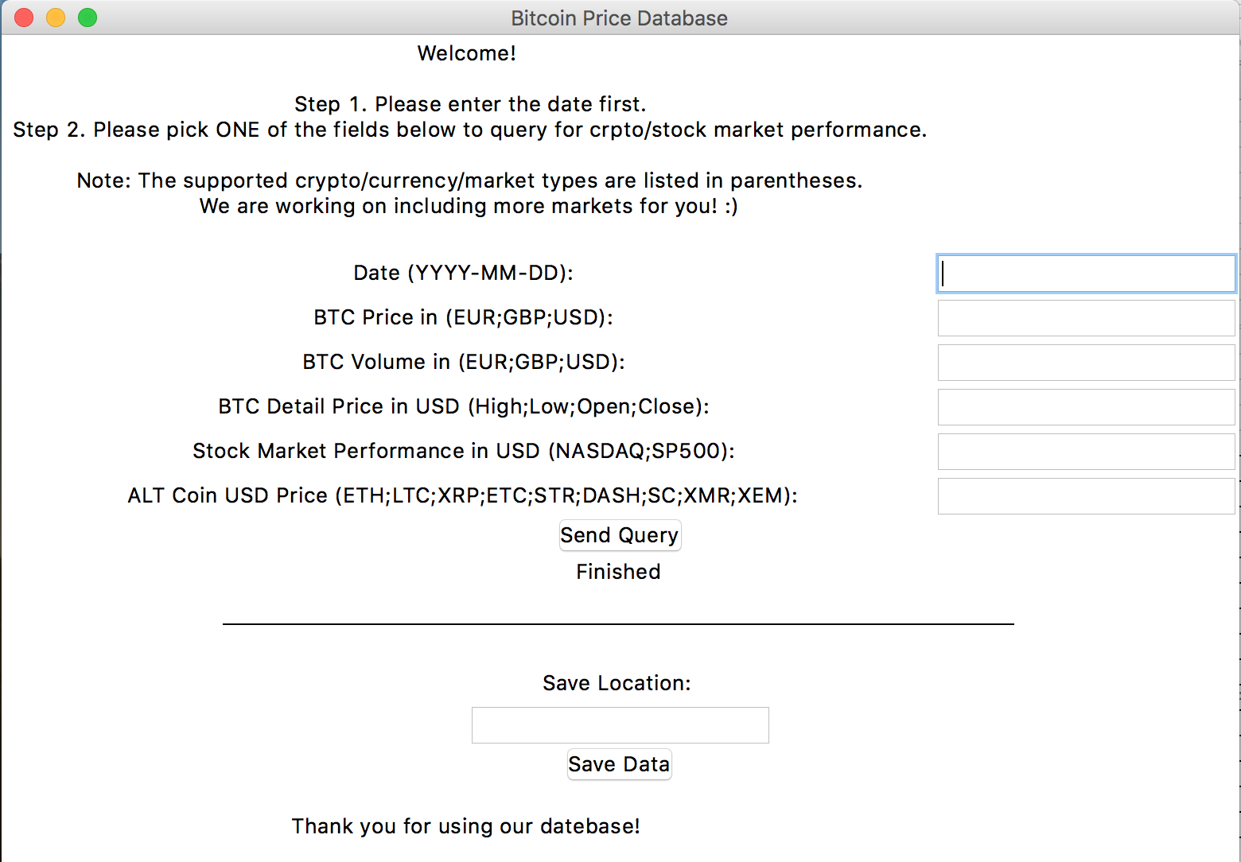
GUI Introduction
Title | Bitcoin Price Database Interface Guide
Comments | Welcome / User guide
Input | Date of price lookup | User input
Input | BTC price in (EUR; GBP; USD) | User input
Input | BTC volume in (EUR; GBP; USD) | User input
Input | BTC in USD details (high; low; open; close) | User input
Input | Stock market performance in USD (NASDAQ; S&P500) | User input
Input | ALT Coin in USD (ETH;LTC;XRP;ETC;STR;DASH;SC;XMR;XEM) | User input
Action | Submit query
Popup Window | Query Result of Price | MySQL output
Feedback | Query status | MySQL output
Comments | Save results location
Input | User input
Action | Save button
Comments | Thanks

Slide 18
Build Graphical User Interface
Design GUI
Understand what we want/ don’t want to query for
Sketch layout
Candidates:
Data Cleaning & Coding
HTML: MySQL password hashing has been updated
PHP: server-side, not dynamic
MySQL Stored Procedure
Python GUI (winner!)
Python Packages
Data Cleaning
Clean up date format with str_to_date, date_format
MySQL date format: upper vs lower case
Coding Lessons Learned
Writing GUI
Error handling with separate variable
Writing SQL in Python: % and %%
Jupyter Notebook
Python Packages
We used below packages:
Tkinter
Pymysql
Pandas
Time
Messagebox
Datetime
Re
Os
Select Technology
Notes:
SELECT Close FROM nasdaq_price WHERE date_format(STR_TO_DATE(Date, '%%m/%%d/%%Y'), '%%Y-%%m-%%d') = '%s' ;

Slide 19
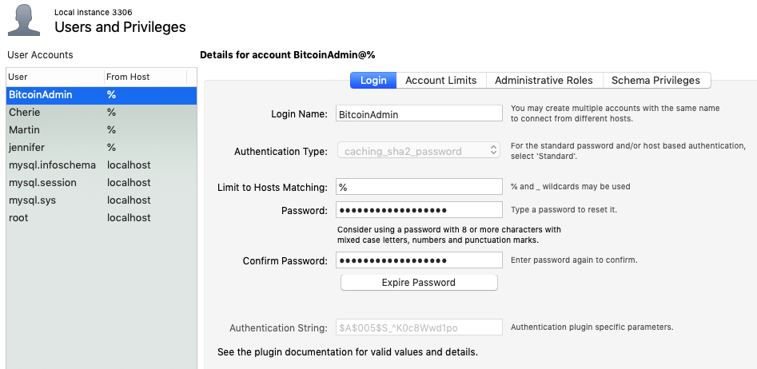
Database User Management

Slide 20
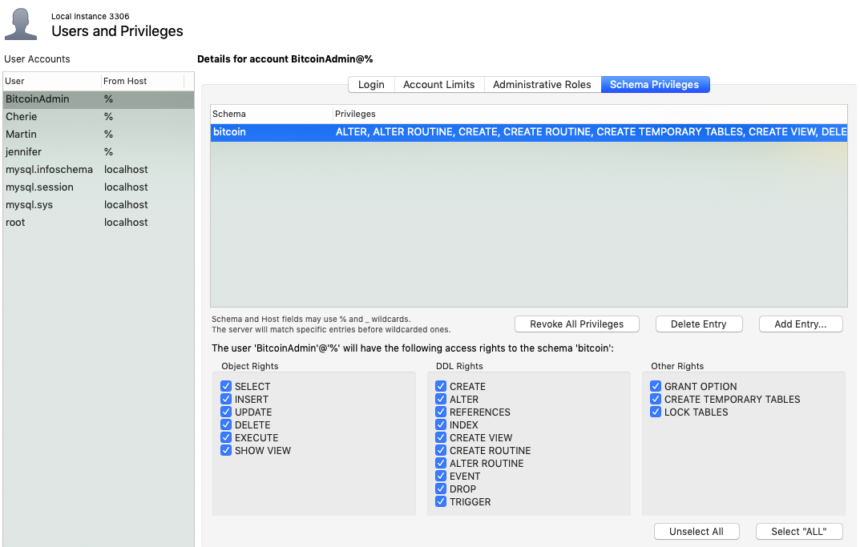
User - Admin

Slide 21
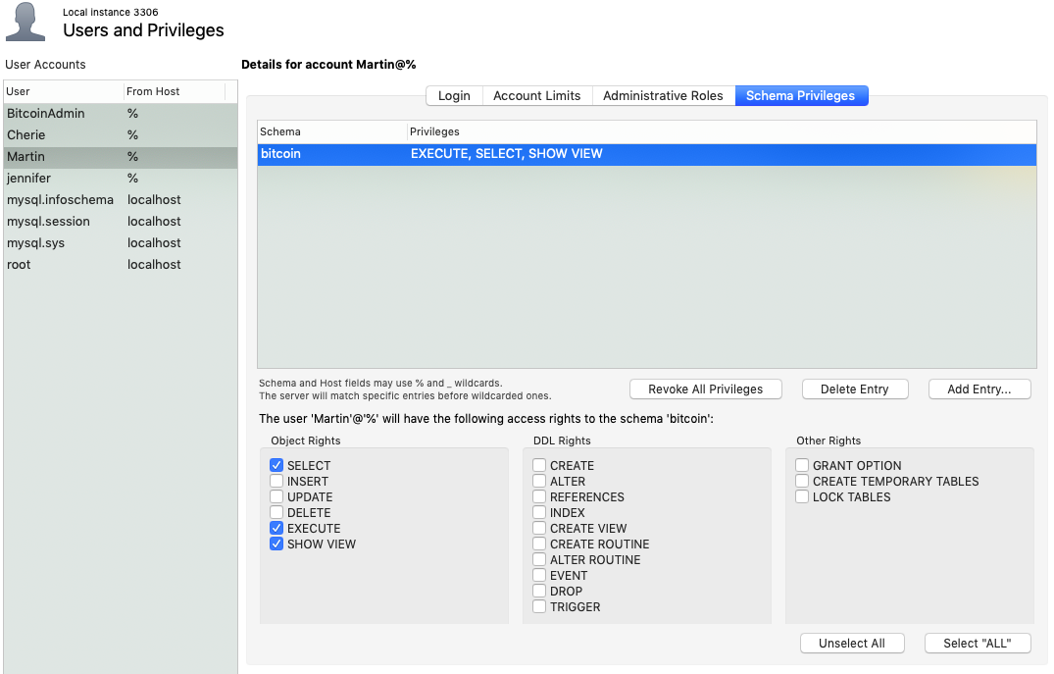
User – Martin

Slide 22
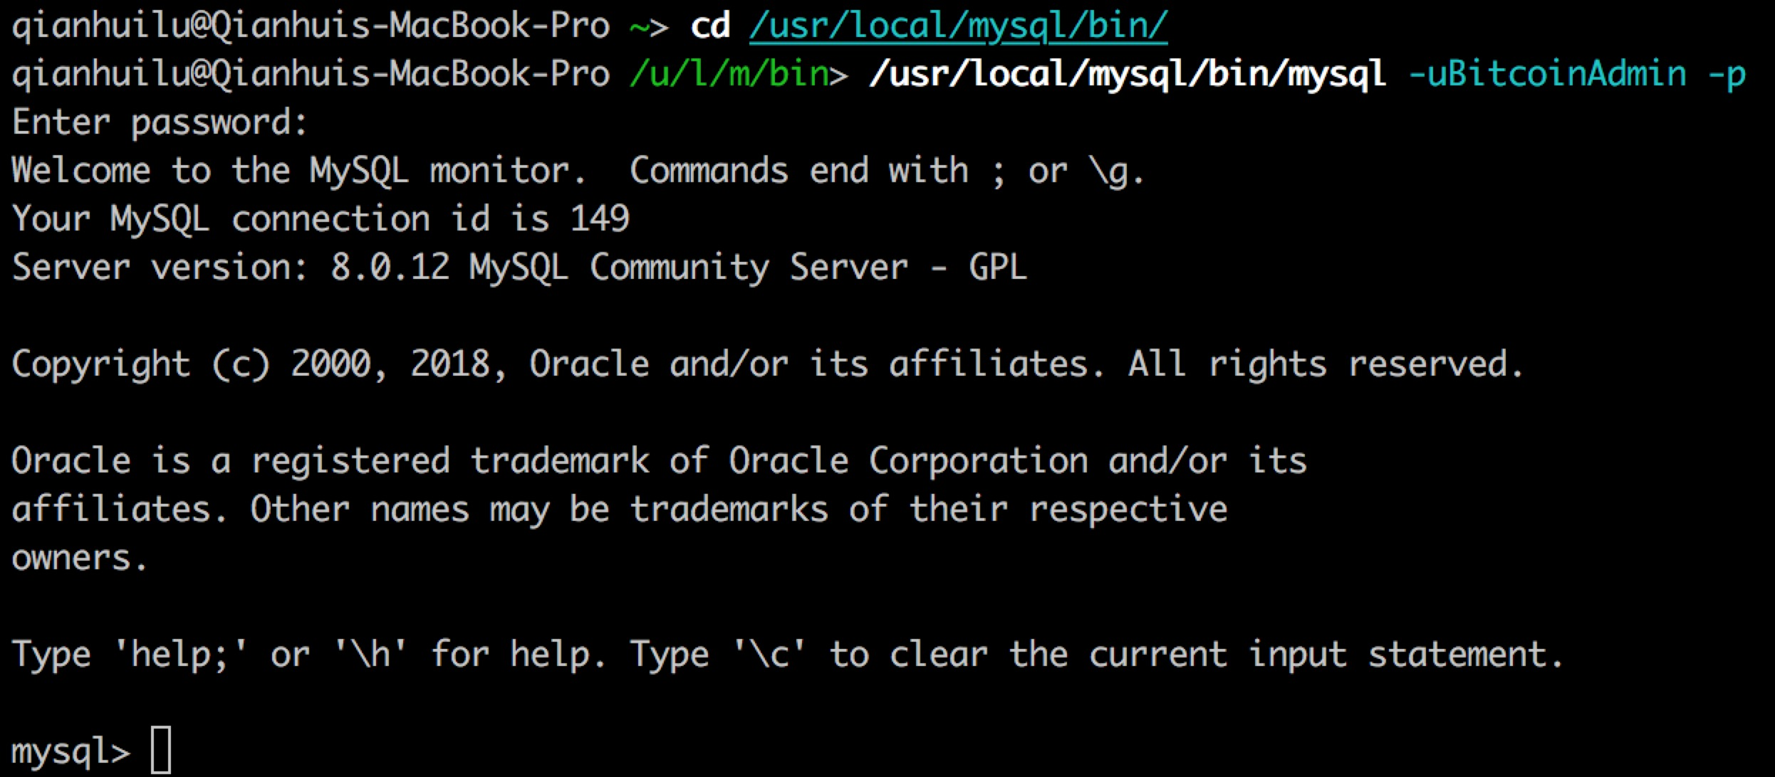
Switch Users Demonstration

Slide 23
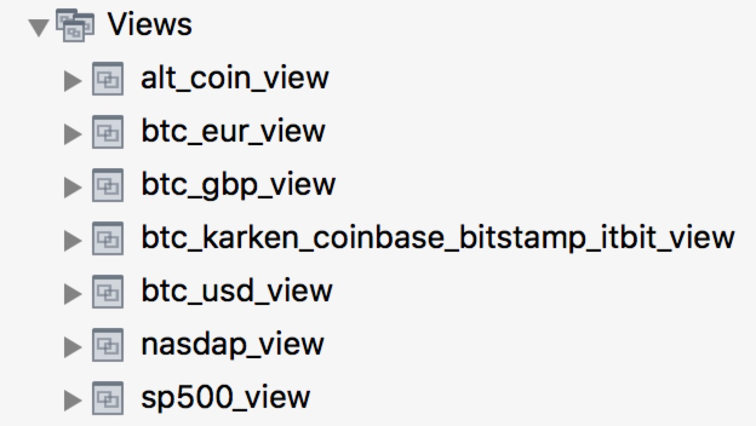
Create View in Database

Slide 24
Now is… Demo Time!
Missions to complete:
2018/10/27 (Saturday)
2018-10-27 BTC in EUR/GBP/USD
2018-10-26 (Friday) NASDAQ/SP500
2017-12-18 BTC high price
2018-10-25 Altcoins recent price
Save data in .csv
+ Plus a quick view at our database!

Slide 25
Results & Visualization

Slide 26
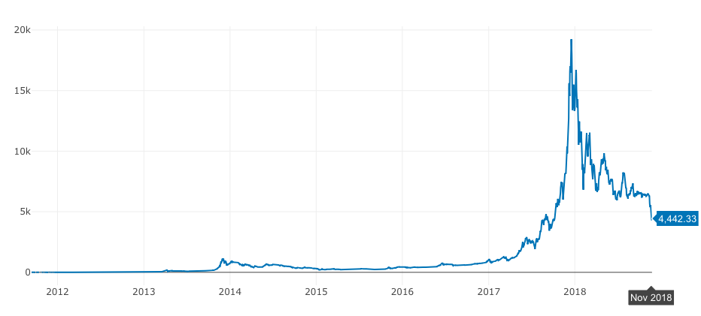
Bitcoin price from 2012-2018

Slide 27
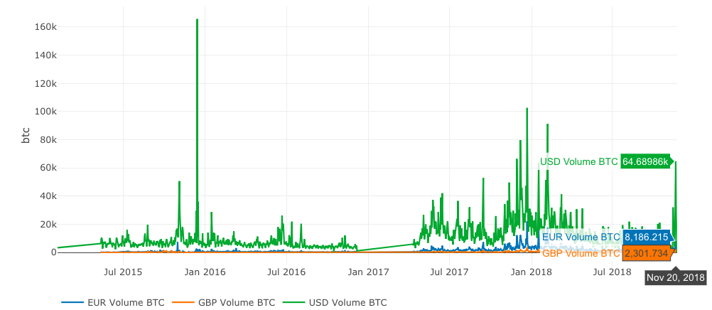
Denomination Currencies

Slide 28
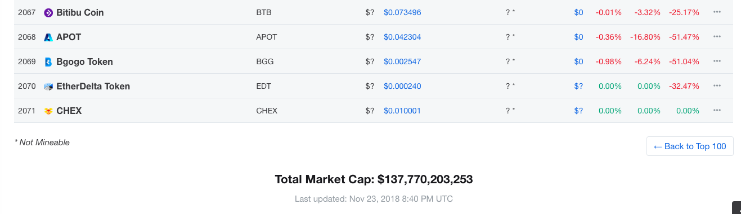
Bitcoin?
Altcoins?
How many altcoins are there?

Slide 29
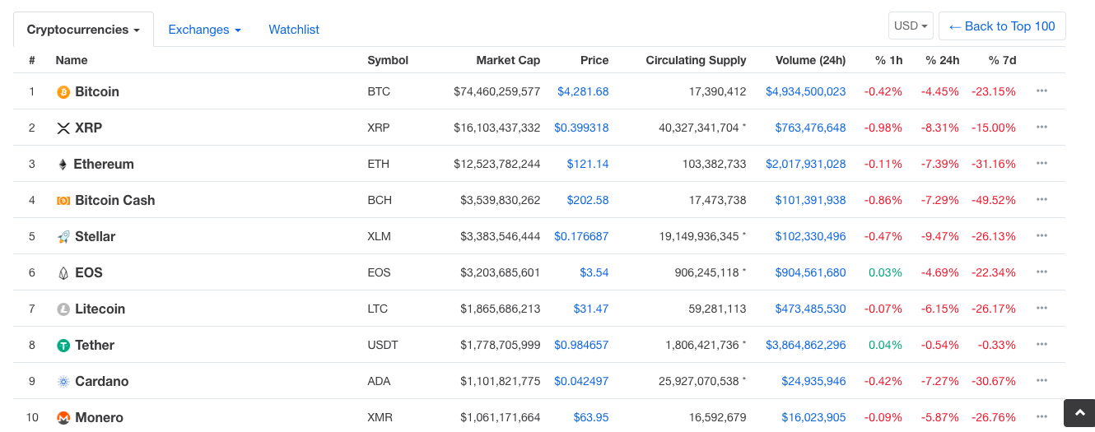
Top 10 cryptocurrencies by Market Cap (CoinMarketCap)

Slide 30
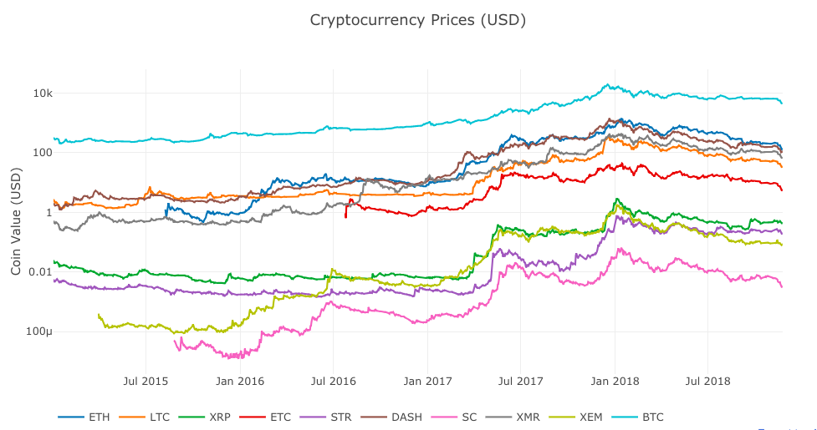
Bitcoin & Altcoins prices

Slide 31
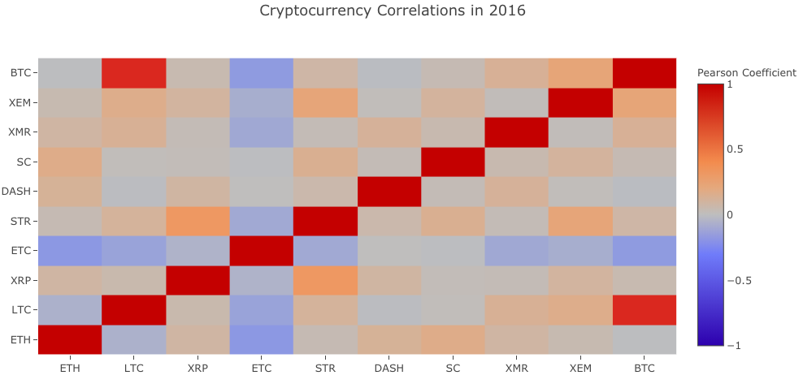
Cryptocurrencies correlation 2016

Slide 32
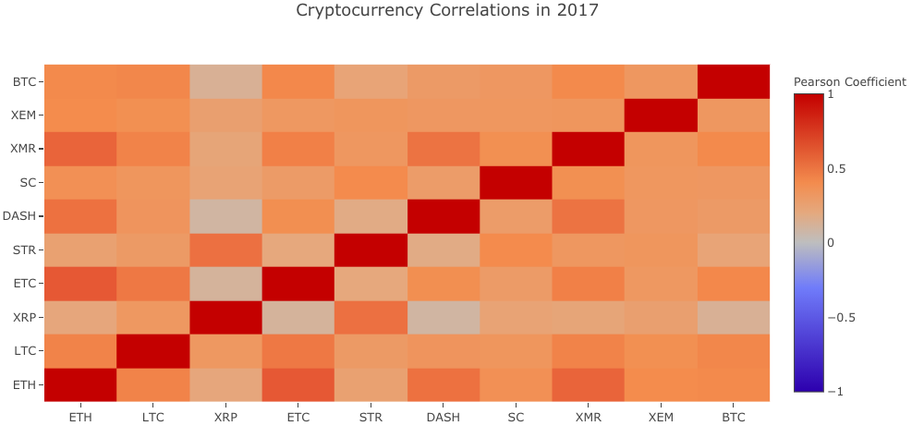
Cryptocurrencies correlation 2017

Slide 33
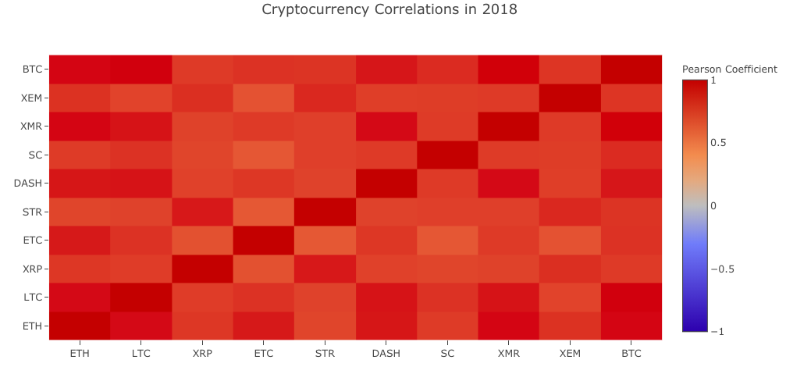
Cryptocurrencies correlation 2018

Slide 34
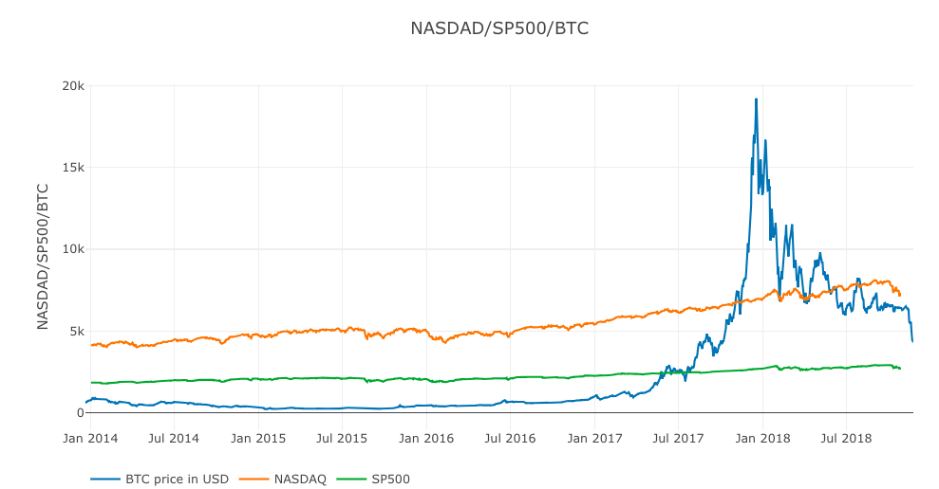
Bitcoin price vs. stock market

Slide 35

How to play in this market?
Or, shall ‘we’ enter the market at all?

Slide 36
Results
01
Higher correlation during market selloff
High Volatility
Higher correlation exacerbates market selloff during market turmoil
02
Unclear regulation outlook
High Regulation Risk
Examples:
People’s Bank of China reinforced regulation in early 2017
03
Compounded by a developing market
Liquidity Risk
Examples:
CME Bitcoin Futures;
Bitcoin ABC fights Bitcoin SV
04
Hackers are not friends
Operation
Risk
Examples: Mt.Gox, BitFloor,Bitstamp,Bitfinex, Poloniex(!)

Slide 37
Q&A

Slide 38
Thank you

